Slide 1
Chapter 5:
Project Scope Management
Information Technology Project Management
Note: See the text itself for full citations.

Slide 2
What is Project Scope Management?
Project scope management includes the processes involved in defining and controlling what is or is not included in a project to achieve its objectives successfully.
Notes:
Project scope management includes the processes involved in defining and controlling what is or is not included in a project
Project scope refers to the detailed outline of all the work required to complete a project successfully. It defines the project's boundaries, objectives, deliverables, and the tasks involved
Scope refers to all the work involved in creating the products of the project and the processes used to create them
A deliverable is a product produced as part of a project, such as hardware or software, planning documents, or meeting minutes

Slide 3
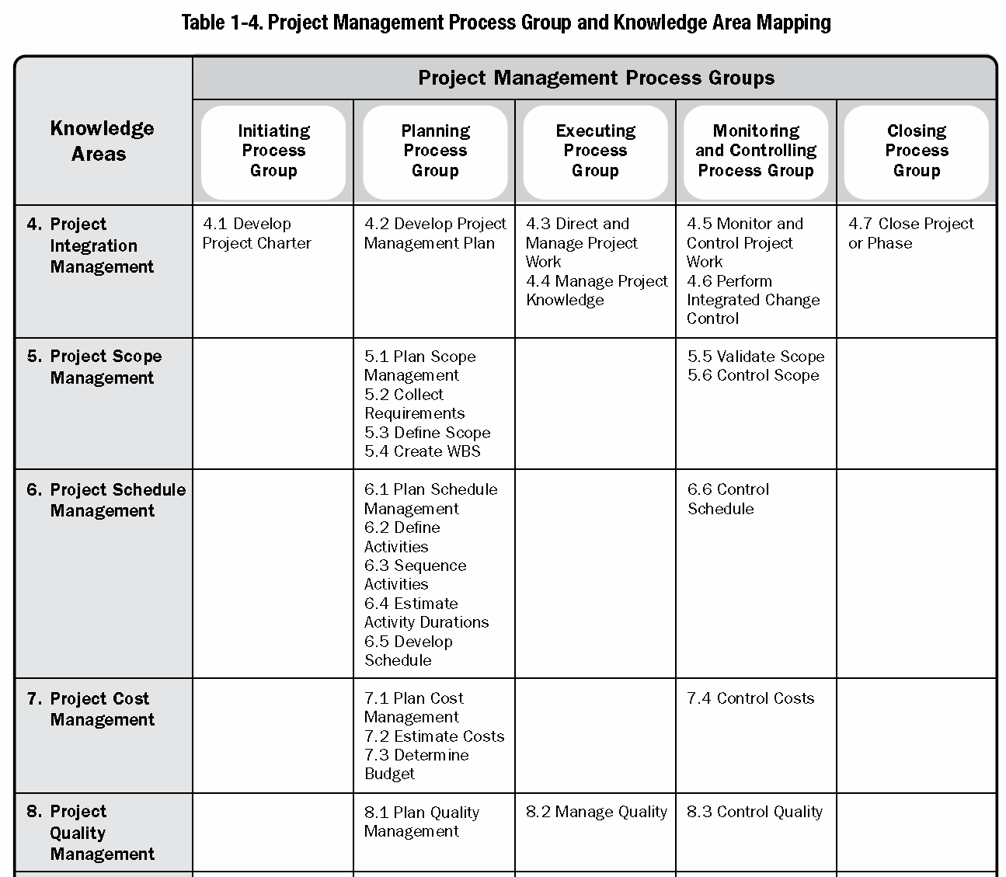
Project Management Process Groups and Knowledge Areas Mapping (1)
Reminder
There are processes from each knowledge area under the “planning” and “monitoring and controlling” process groups.
“planning”
“monitoring and controlling”

Slide 4
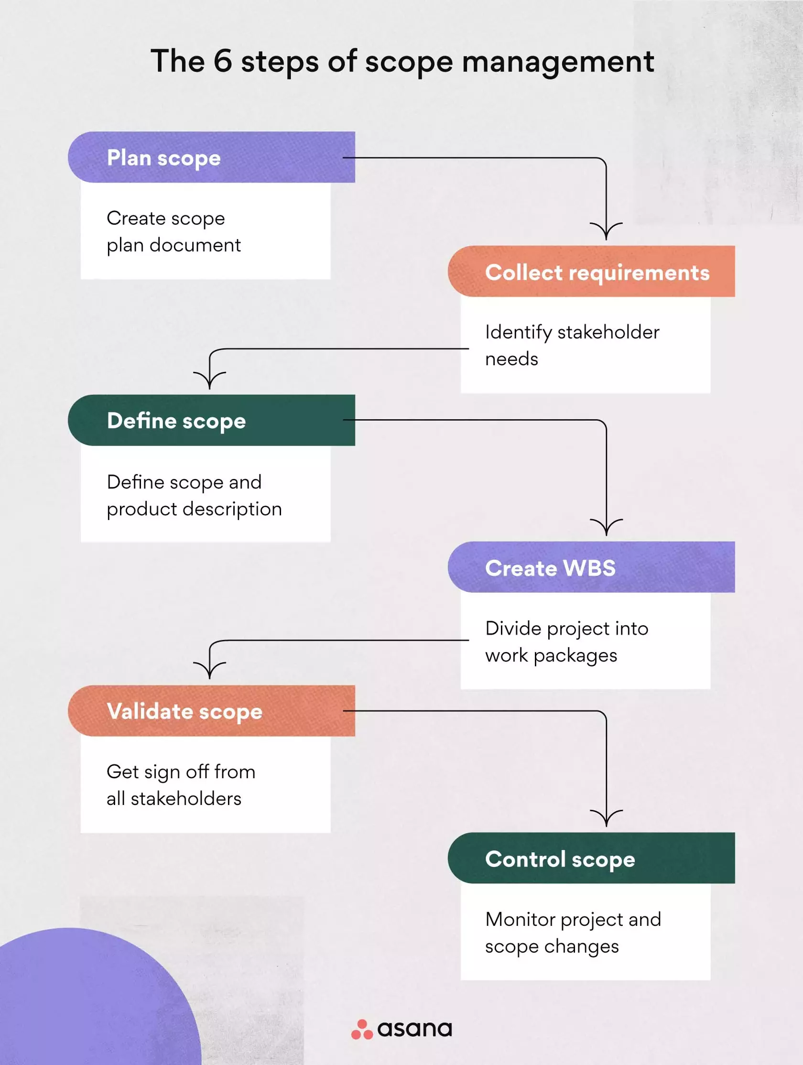

Slide 5
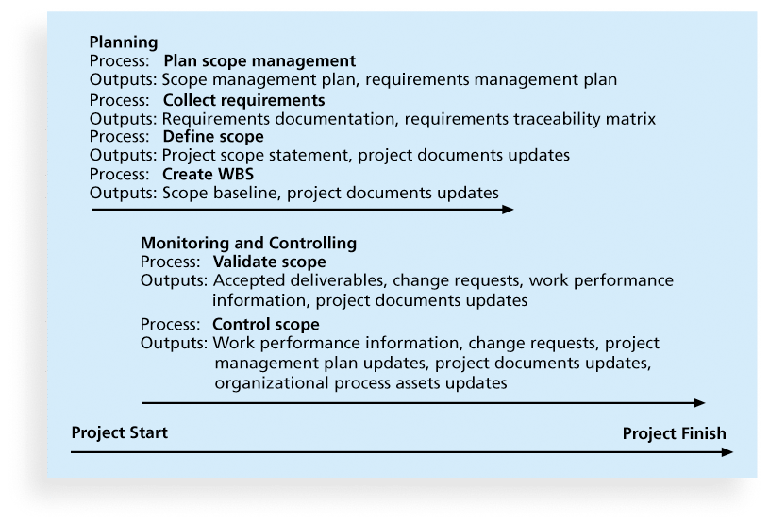
Figure 5-1. Project Scope Management Summary

Slide 6
5.1- Planning Scope Management
Planning scope: determining how the project’s scope and requirements will be managed
The two important outputs:
Scope management plan
Requirements management plan
Notes:
The scope management plan is a subsidiary part of the project management plan
Developing a detailed plan for how the scope will be defined, managed, and controlled throughout the project lifecycle.

Slide 7
5.2- Collecting Requirements
Collecting requirements: defining and documenting the features and functions of the products produced during the project as well as the processes used for creating them
The two important outputs:
Requirements Documentation
Requirements Traceability Matrix RTM
Notes:
It is important to use an iterative approach to defining requirements since they are often unclear early in a project
For some IT projects, it is helpful to divide requirements development into categories called elicitation, analysis, specification, and validation

Slide 8
Methods for Collecting Requirements
Interviewing
Focus groups and workshops
Using group creativity and decision-making techniques
Questionnaires and surveys
Observation
Prototyping
Benchmarking, comparing specific project practices or product characteristics to those of other projects or products inside or outside the performing organization, can also be used to collect requirements
Notes:
A questionnaire is the term used to describe the set of questions you’re asking an individual. A survey is the process of collecting, analysing and interpreting data from many individuals. It aims to determine insights about a group of people. A survey goes much deeper than a questionnaire and often involves more than one form of data collection.

Slide 9
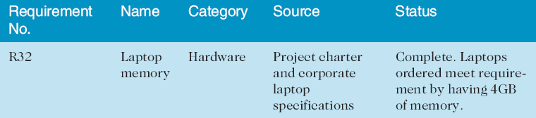
Requirements Traceability Matrix
A requirements traceability matrix (RTM) is a table that lists requirements, various attributes of each requirement, and the status of the requirements to ensure that all requirements are addressed

Slide 10
5.3- Defining Scope
Defining scope: Documents the features and functionality of the product, service, or result.
The two important outputs:
Project document updates
Project scope statements
Notes:
It is also helpful to document other scope-related information, such as the project boundaries, constraints, and assumptions. The project scope statement should also reference supporting documents, such as product specifications

Slide 11
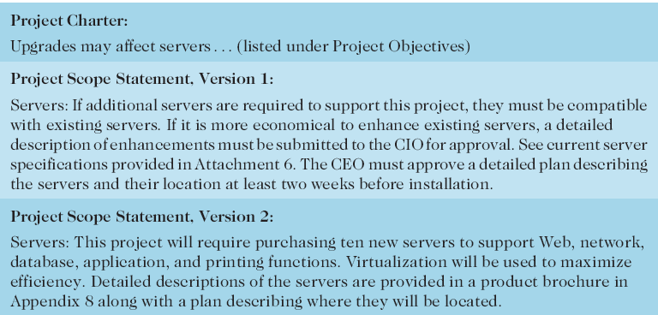
Table 5-3: Further Defining Project Scope

Slide 12

5.4- Creating the Work Breakdown Structure (WBS)
Creating the WBS: subdividing the major project deliverables into smaller, more manageable components
Notes:
A WBS is a deliverable-oriented grouping of the work involved in a project that defines the total scope of the project
WBS is a foundation document that provides the basis for planning and managing project schedules, costs, resources, and changes
Decomposition is subdividing project deliverables into smaller pieces
A work package is a task at the lowest level of the WBS
The scope baseline includes the approved project scope statement and its associated WBS and WBS dictionary

Slide 13
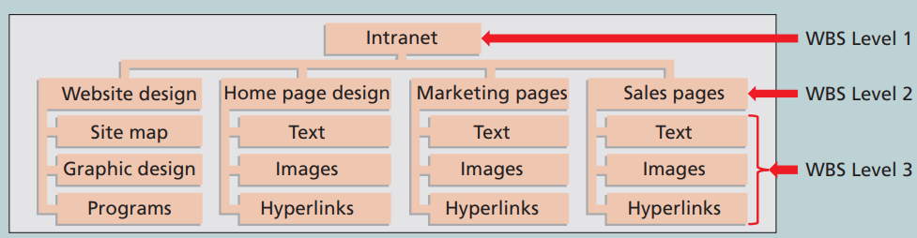
Figure 5-3. Sample Intranet WBS
Organized by Product

Slide 14
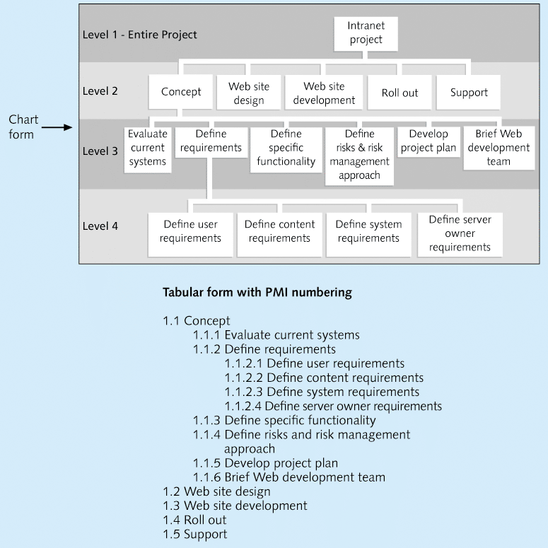
Figure 5-4. Sample Intranet WBS Organized by Phase

Slide 15
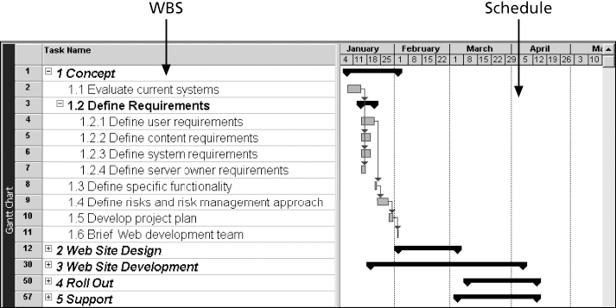
Figure 5-5. Intranet WBS and Gantt Chart in Microsoft Project

Slide 16
Approaches to Developing WBSs
The analogy approach: Review WBSs of similar projects and tailor to your project
The top-down approach: Start with the largest items of the project and break them down
The bottom-up approach: Start with the specific tasks and roll them up
Mind-mapping approach: Mind mapping is a technique that uses branches radiating out from a core idea to structure thoughts and ideas
Notes:
Using guidelines: Some organizations, like the DOD, provide guidelines for preparing WBSs

Slide 17
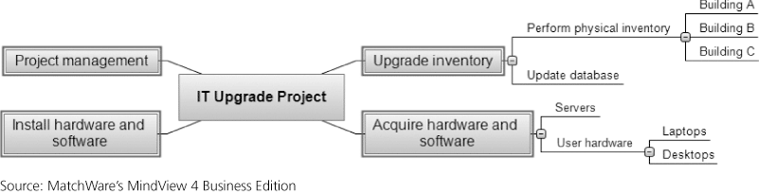
Figure 5-7. Sample Mind-Mapping Approach for Creating a WBS

Slide 18
5.5- Validating Scope
Gaining formal acceptance from stakeholders that the deliverables meet the established requirements and standards.
Acceptance is often achieved by a customer inspection and then sign-off on key deliverables

Slide 19
5.6- Controlling Scope
Monitoring the project’s scope to manage changes and ensure that it stays aligned with the project objectives.
Variance is the difference between planned and actual performance

Slide 20
Best Practices for Avoiding Scope Problems
1. Keep the scope realistic. Break large projects down into a series of smaller ones
2. Involve users in project scope management.
3. Use off-the-shelf hardware and software whenever possible.
4. Follow good project management processes.
Notes:
1. Keep the scope realistic. Don’t make projects so large that they can’t be completed. Break large projects down into a series of smaller ones
2. Involve users in project scope management. Assign key users to the project team and give them ownership of requirements definition and scope verification
3. Use off-the-shelf hardware and software whenever possible. Many IT people enjoy using the latest and greatest technology, but business needs, not technology trends, must take priority
4. Follow good project management processes. As described in this chapter and others, there are well-defined processes for managing project scope and others aspects of projects

Slide 21
Chapter Summary
Project scope management includes the processes required to ensure that the project addresses all the work required, and only the work required, to complete the project successfully
Main processes include
  Define scope management
  Collect requirements
  Define scope
  Create WBS
  Validate scope
  Control scope

Slide 22
Questions
What are the key processes involved in project scope management?
What techniques can be used to define and document project scope effectively?
Describe different ways to develop a WBS.

